Slide 1

Interactive Quiz Master
Computer Based Test (CBT) Interface
Subject: JavaScript
GROUP 1
SAHIL GHONE – 150096725002
RAAD DALWAI – 150096725207
ARAYAN KUCHEKAR – 150096725048
NANDINI SOLANKI – 150096725189

Slide 2

Index
INTRODUCTION
Interactive Quiz Master is a web-based CBT system.
It allows quiz creation, online assessment, and evaluation.
Designed to replace traditional paper-based exams.
Provides instant results and feedback.
Developed using HTML, CSS, and JavaScript.

Slide 3
Index
PROBLEM STATEMENT
Manual exams are:
  Time-consuming
  Error-prone
Result processing takes time.
Existing systems need backend & database.
Need: A simple, browser-based quiz system without backend dependency.

Slide 4
Index
OBJECTIVES
Create a user-friendly quiz application.
Enable easy quiz creation and management.
Conduct time-based online tests.
Provide automatic result calculation.
Store data using local storage.

Slide 5
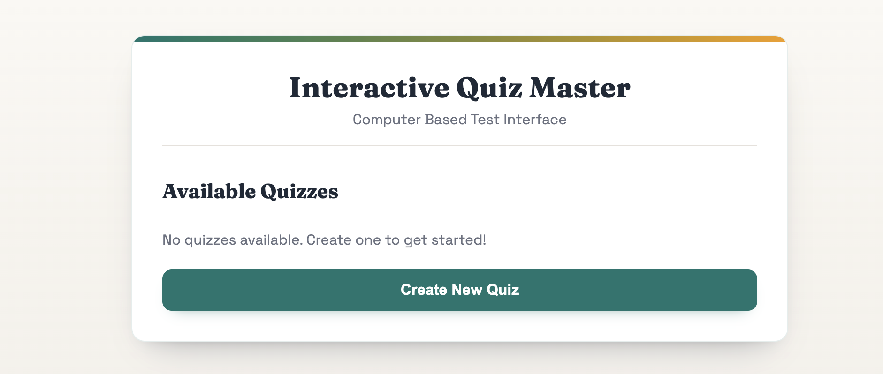
Index
SYSTEM DESIGN
Main Modules:
Quiz Creator
Dashboard
Quiz Setup & Timer
Quiz Attempt
Result & Review
Design Approach:
Single Page Application (SPA)
Client-side execution

Slide 6
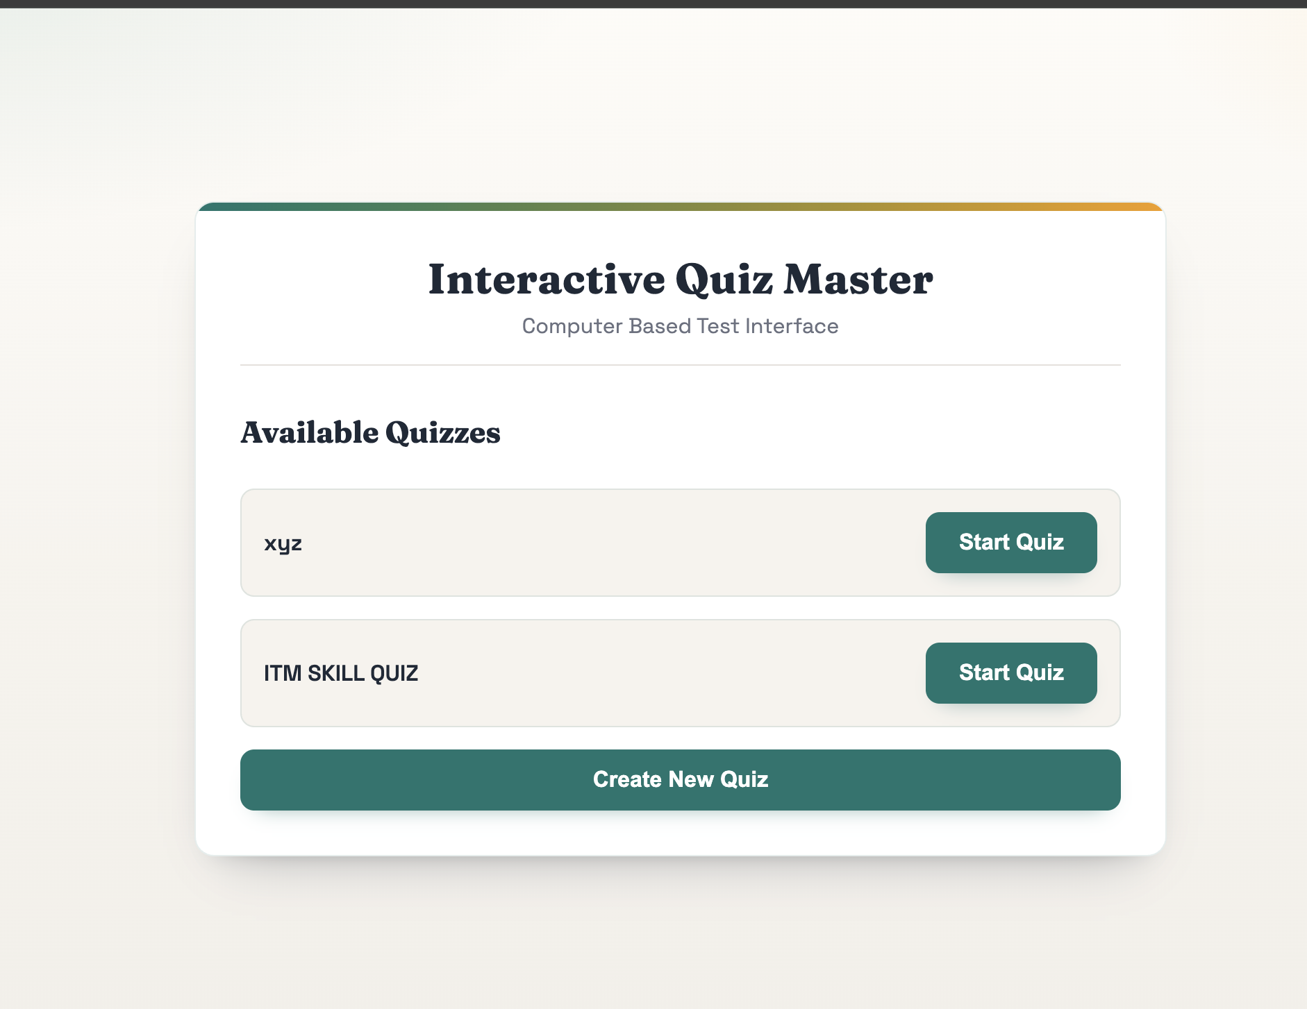
Index
QUIZ CREATION & DASHBOARD
Create quiz with:
  Quiz title
  Questions
  Multiple-choice options
Select correct answer for each question.
Dashboard displays:
  All saved quizzes
  Start quiz option

Slide 7
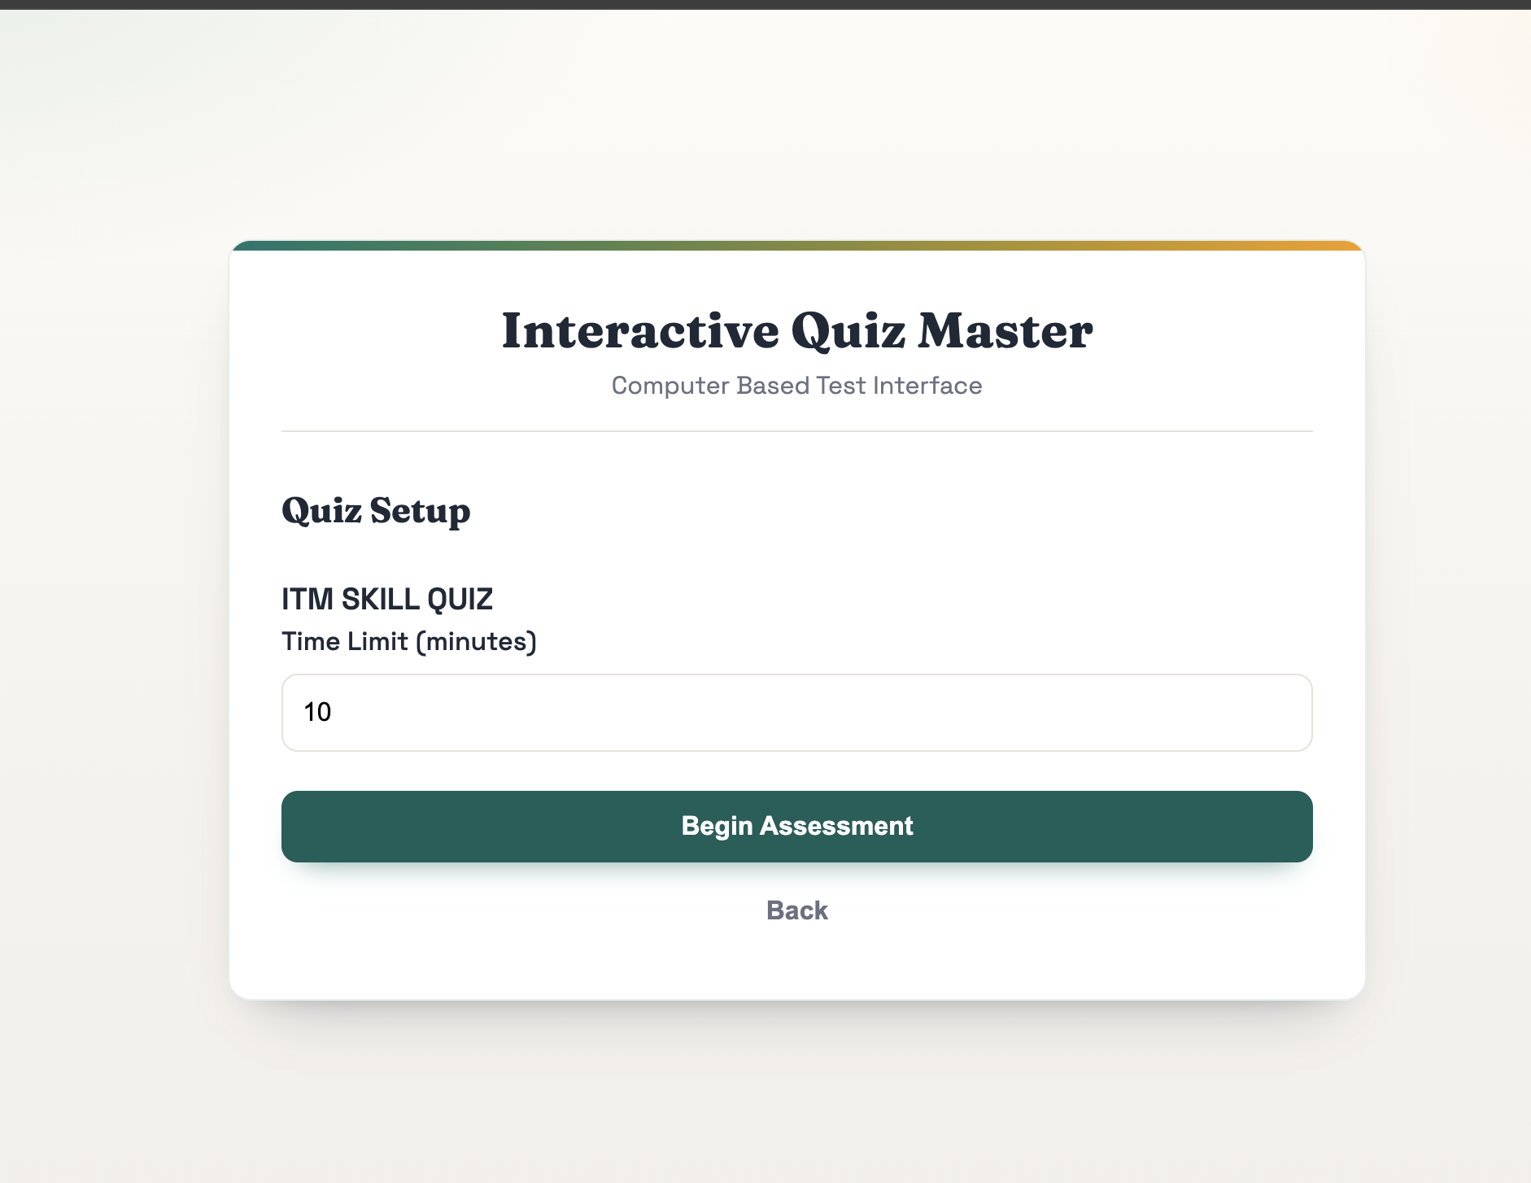
Index
QUIZ EXECUTION
User sets time limit before starting.
Timer runs during the quiz.
One question shown at a time.
User must select an answer to continue.
Quiz auto-submits when time ends.

Slide 8
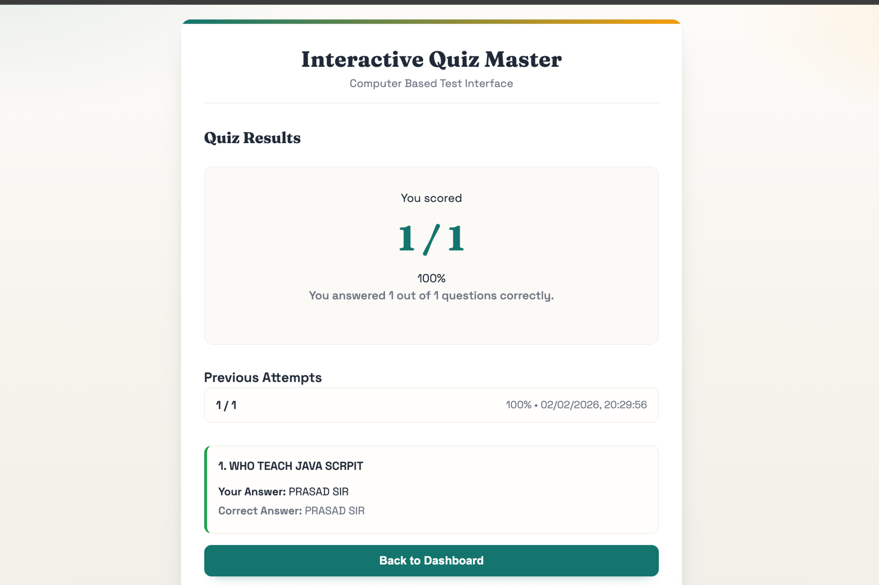
Index
RESULT & REVIEW
Automatic score calculation.
Displays:
  Total marks
  Percentage
Shows:
  Correct answers
  User’s answers
Stores previous attempts.

Slide 9
Index
TECHNOLOGIES USED
HTML5 – Page structure
CSS3 – Styling and responsiveness
JavaScript – Logic, timer, validation
Local Storage – Data persistence

Slide 10
Index
CONCLUSION
Interactive Quiz Master automates online assessments.
Reduces manual work and errors.
Provides fast and accurate results.
Easy to use and efficient.
Suitable for academic and institutional use.

Slide 11
Thank You

